Slide 1

Healthcare Data Analysis
Exploring patient demographics, diagnoses, and lab results across 189 patient records from four Indian cities.

Slide 2

DATASET OVERVIEW
Data Foundation
189
50
4
Total Records
Unique Patients
Cities
Patient observations analyzed
Individual patient IDs tracked
Geographic locations covered
Dataset Composition
Three merged datasets provide comprehensive patient information: demographics (age, gender, city), diagnoses (disease type, severity), and lab results (test names and values). No missing values detected across all fields.
Age range: 19-69 years | Mean age: 44.9 years

Slide 3
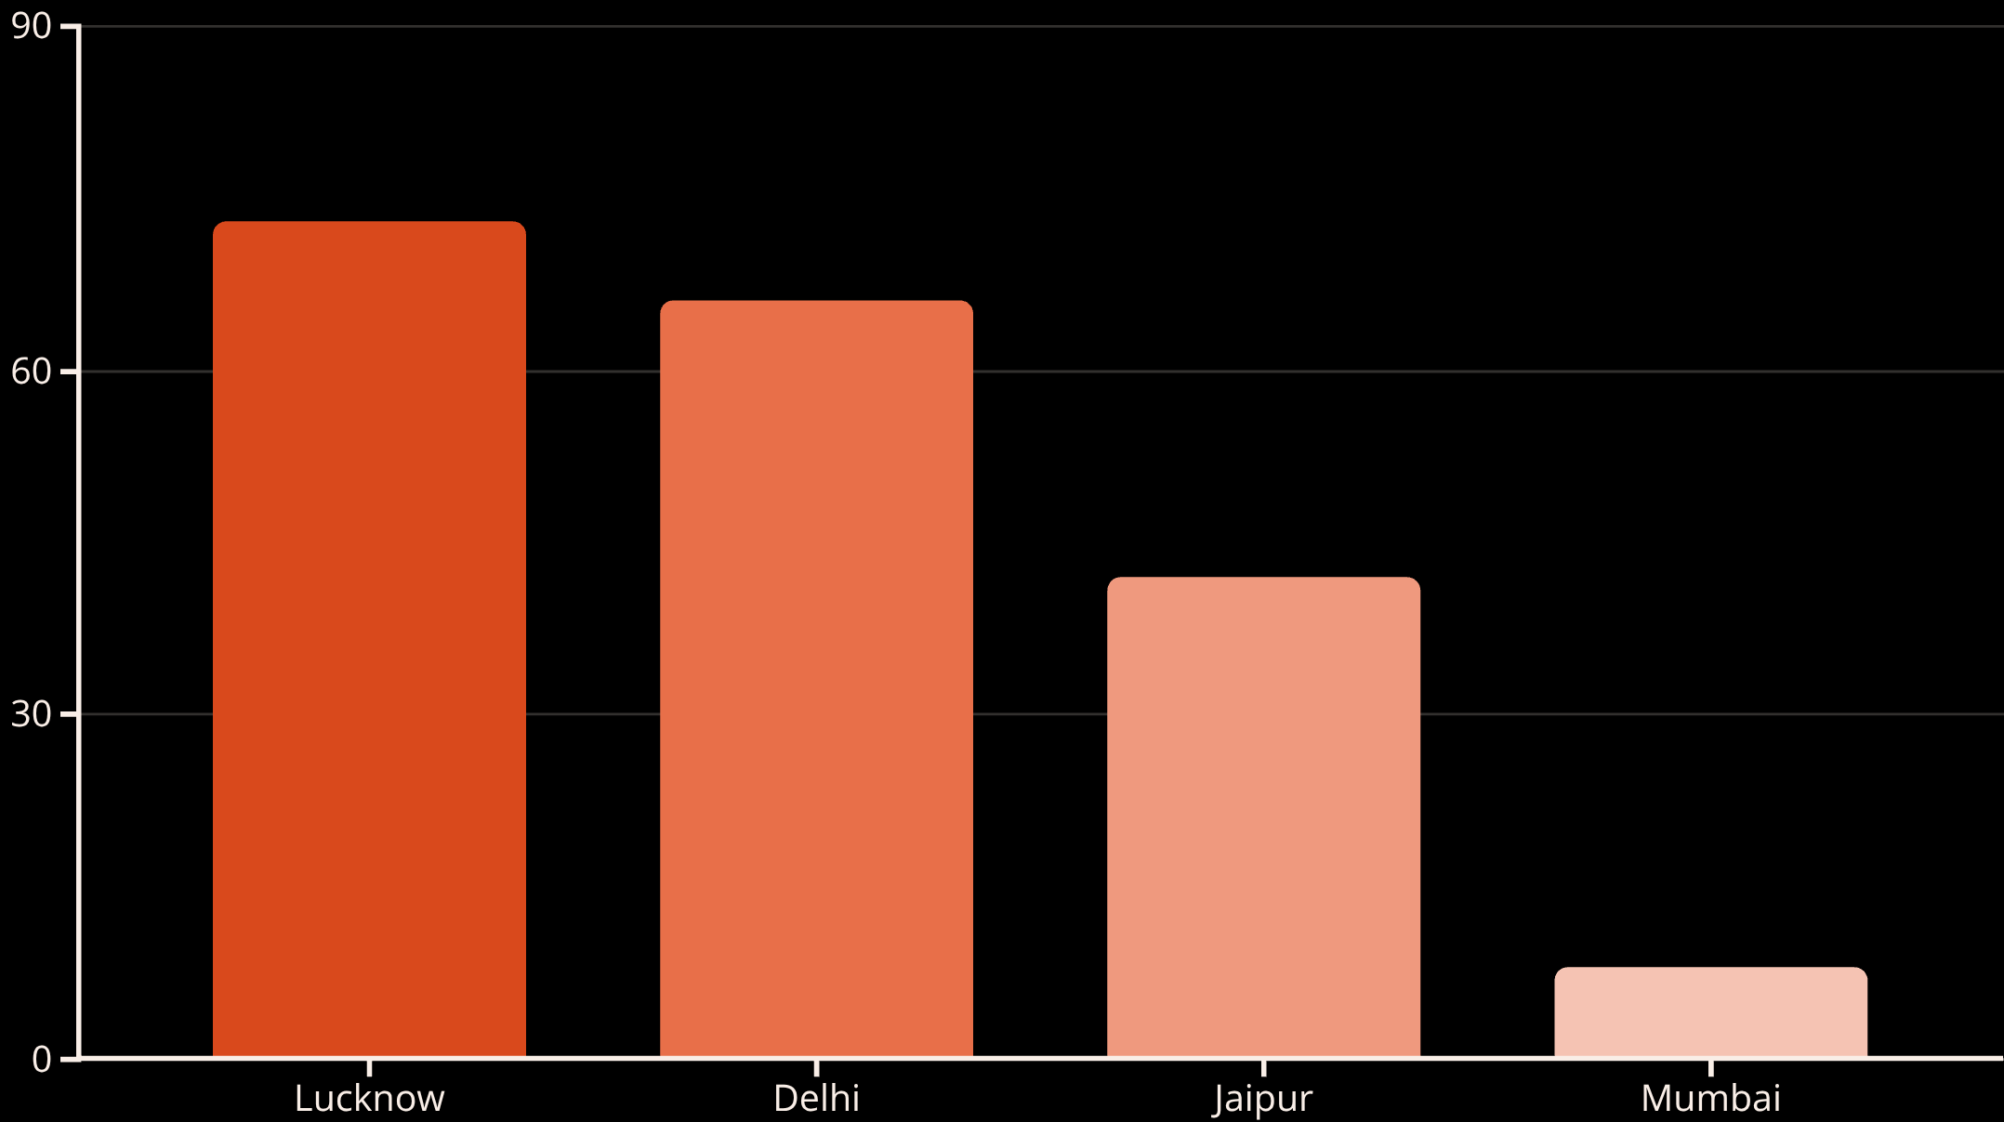
Geographic Distribution
City Insights
Lucknow leads with 73 patients, followed by Delhi (66) and Jaipur (42). Mumbai shows significantly lower representation with only 8 patients.
Average ages by city: Mumbai (56.4 years), Jaipur (49.1), Lucknow (45.5), Delhi (40.0)
Delhi patients show the highest average lab values at 166.7, while Mumbai records the lowest at 151.8.

Slide 4

Patient Demographics
Gender Split
Age Distribution
Risk Profile
Female patients significantly outnumber males in the dataset, with females showing slightly higher average lab values (161.6 vs 155.4).
Bimodal distribution with peaks around ages 40 and 58. Patients over 50 represent a substantial portion of the dataset.
53.4% of patients classified as high-risk based on above-average lab values (>159.2).

Slide 5
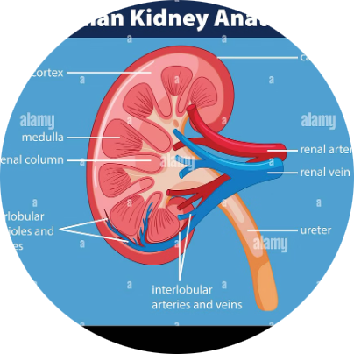

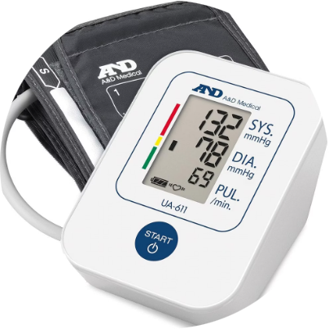
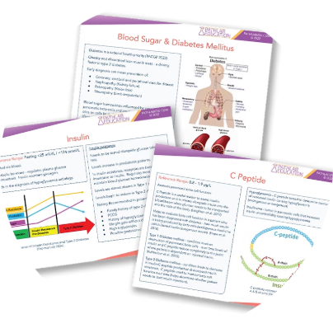
DISEASE ANALYSIS
Top Diagnoses
Disease Prevalence
CKD (Chronic Kidney Disease) is the most common diagnosis with 56 cases, followed by NAFLD (47), Hypertension (45), and Diabetes (41).
CKD
NAFLD
Hypertension
56 cases | Avg age: 42.9
47 cases | Avg age: 47.9
45 cases | Avg age: 42.9
Severe cases: Diabetes leads with 18 severe cases, followed by Hypertension (17), NAFLD (16), and CKD (16).
Diabetes
41 cases | Avg age: 46.2

Slide 6
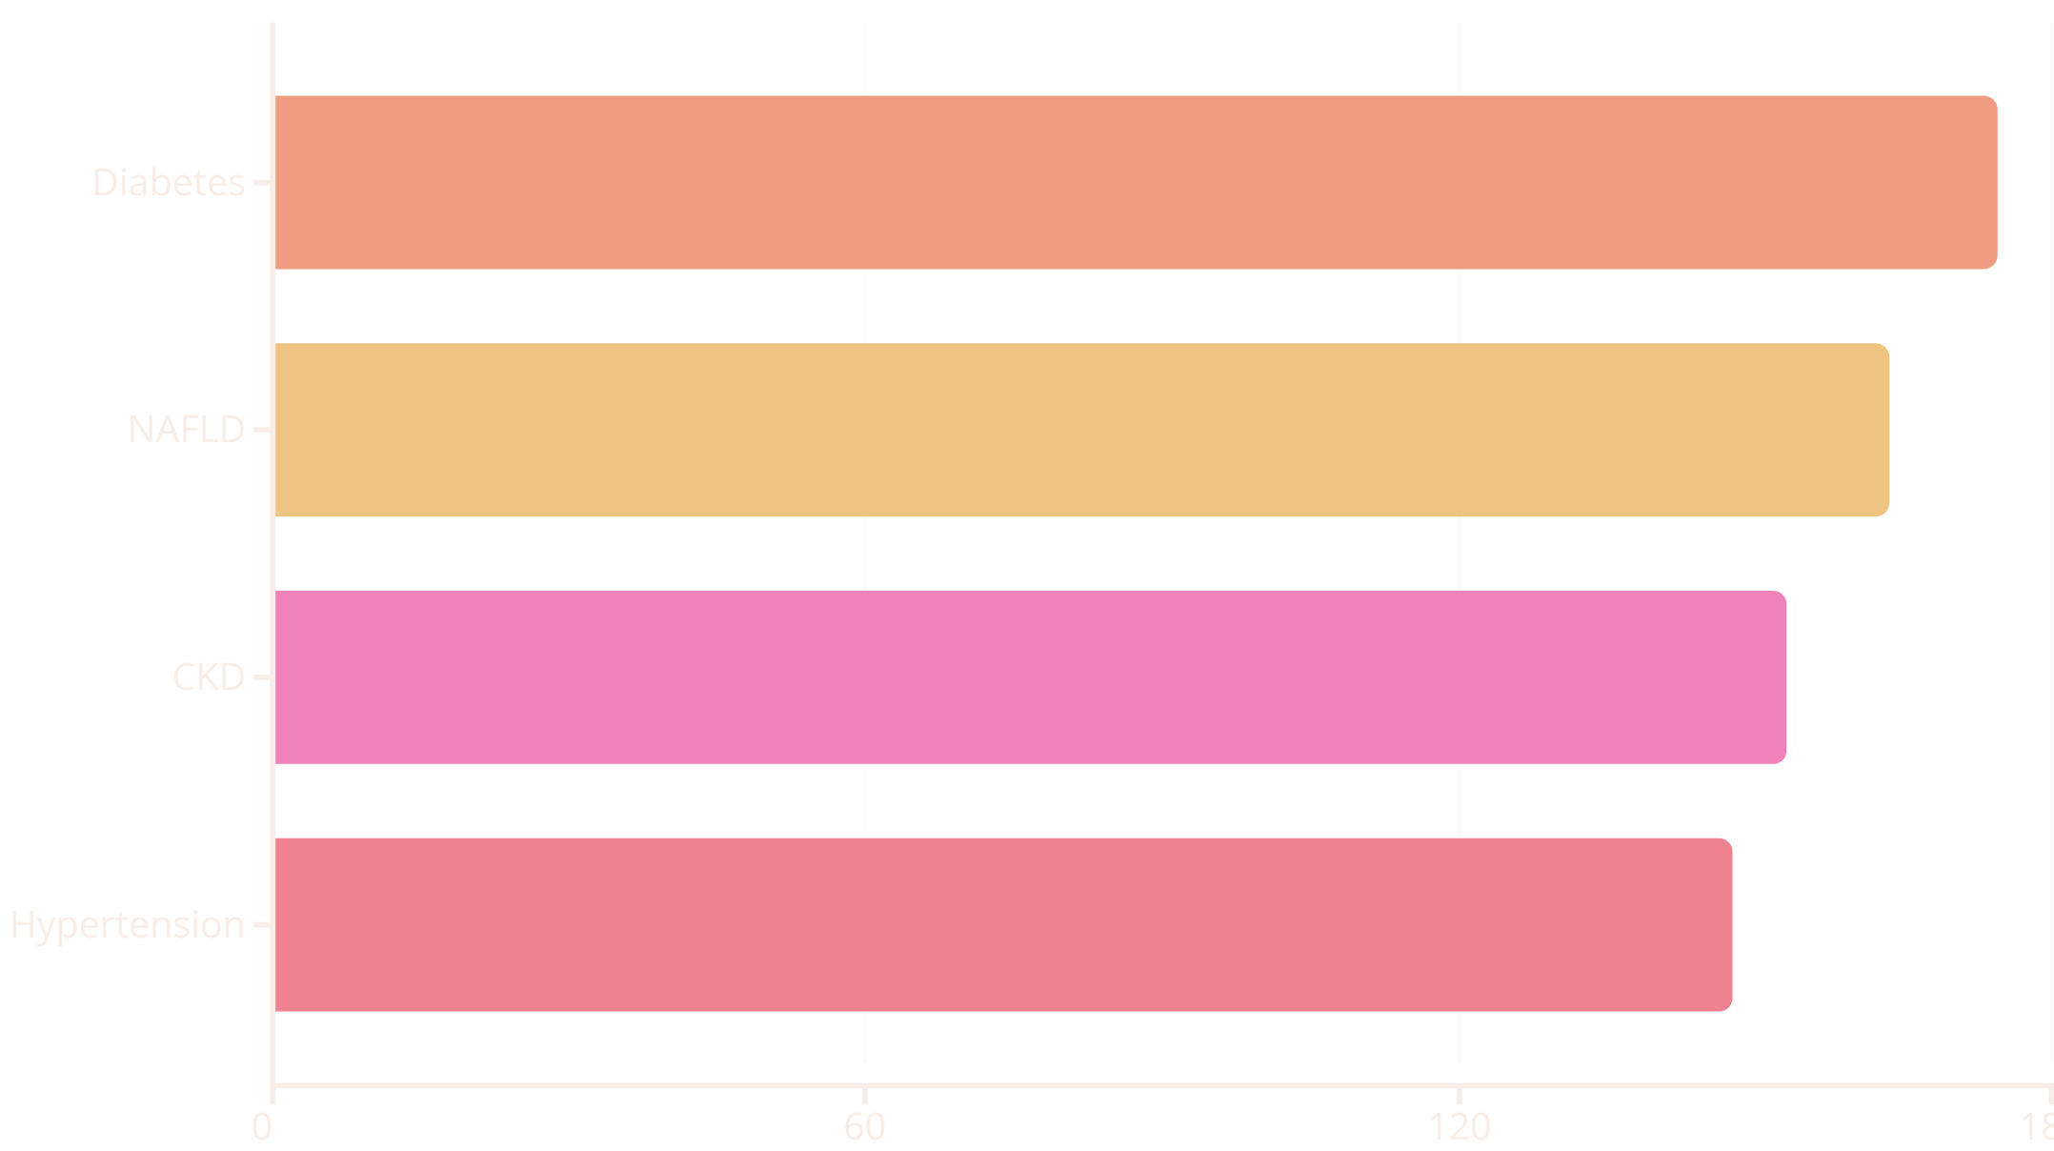
Lab Results Analysis
Key Findings
Diabetes patients show the highest average lab values (174.5), while Hypertension patients record the lowest (147.8).
Lab value range: 52.2 to 248.1
Test types: BP (168.7 avg), Creatinine (159.7), ALT (158.2), Blood Sugar (148.4)
The highest recorded lab value was 248.1, indicating severe cases requiring immediate attention.

Slide 7
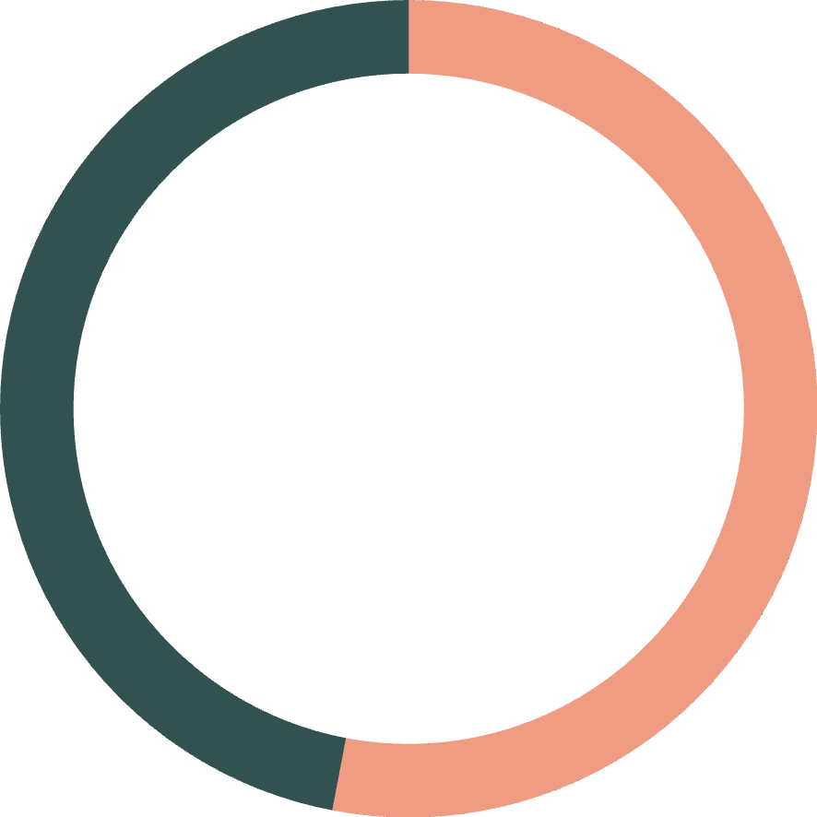
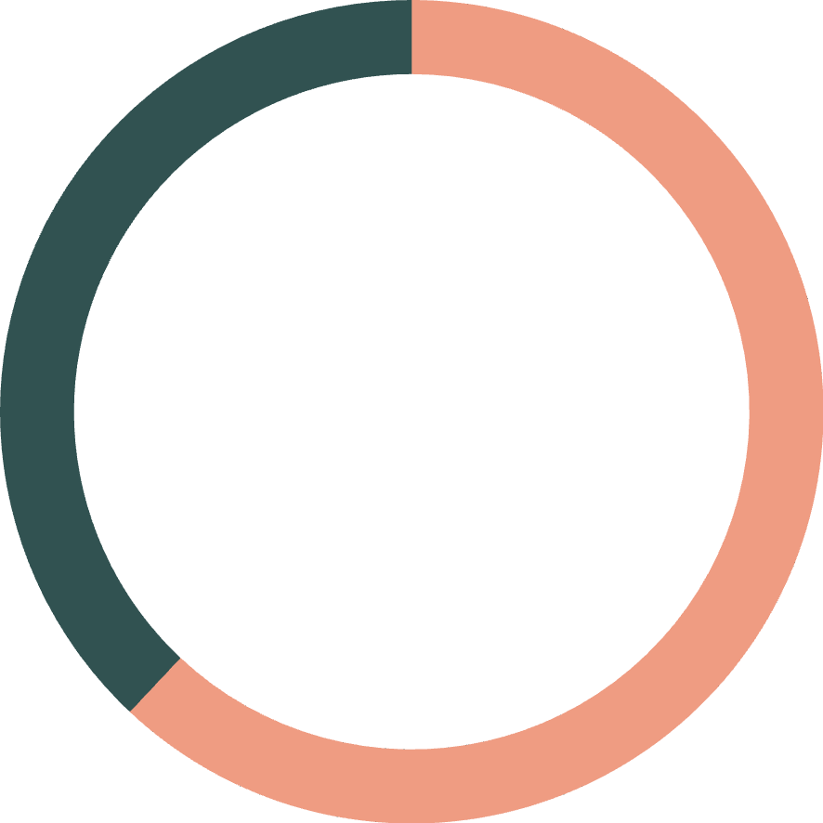
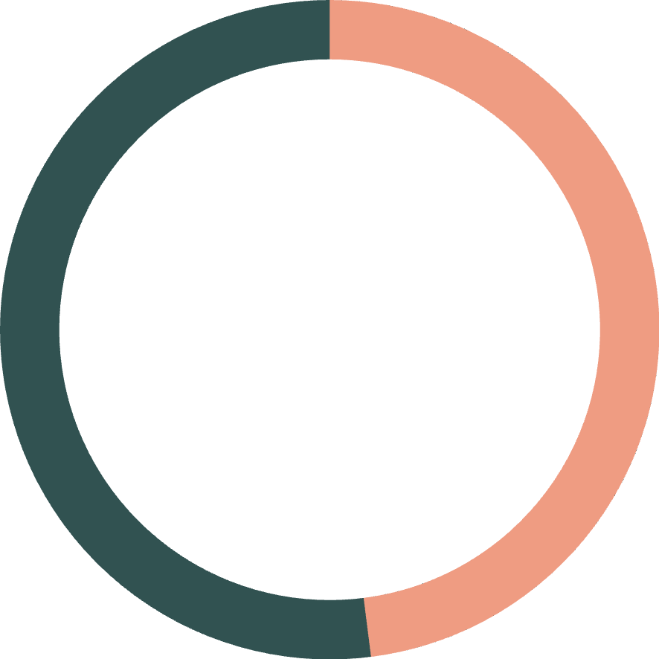
High-Risk Patient Profile
53%
62%
48%
High-Risk Patients
Jaipur Risk Rate
Lucknow Risk Rate
101 patients with above-average lab values
Highest abnormal percentage by city
Lowest abnormal percentage
Risk classification based on lab values exceeding the dataset mean of 159.2. Jaipur shows the highest risk concentration at 61.9%, while Lucknow demonstrates better outcomes at 47.9%.

Slide 8
AGE PATTERNS
Age-Related Insights
Patients Over 50
Age-Lab Correlation
75 patients aged 50+ analyzed for disease patterns
Weak positive correlation (0.043) between age and lab values suggests disease severity is not strongly age-dependent across the full dataset.
NAFLD: 24 cases (most common)
CKD: 21 cases
Diabetes: 15 cases
Disease-specific patterns: Hypertension shows the strongest age correlation (0.26), while Diabetes shows slight negative correlation (-0.12).
NAFLD shows the highest average age at 47.9 years, suggesting age-related disease progression.

Slide 9
City-Specific Disease Patterns
Delhi
Jaipur
Lucknow
Mumbai
Most common: NAFLD
Most common: Hypertension
Most common: Diabetes
Most common: Diabetes
Avg age: 40.0 years (youngest)
Avg age: 49.1 years
Avg age: 45.5 years
Avg age: 56.4 years (oldest)
Avg lab: 166.7 (highest)
Risk rate: 61.9% (highest)
Risk rate: 47.9% (lowest)
Avg lab: 151.8 (lowest)

Slide 10

Key Takeaways
Disease Burden
CKD represents the highest case volume (56), while Diabetes shows the most severe lab abnormalities (174.5 average).
Geographic Variation
Significant differences exist across cities in disease prevalence, patient age, and risk profiles—Jaipur requires targeted intervention.
Risk Stratification
Over half of patients (53.4%) classified as high-risk based on lab values, indicating substantial need for enhanced monitoring and treatment protocols.

